Slide 1
Multispectral Imaging for Fine-Grained Recognition of Powders on Complex Backgrounds
Tiancheng Zhi, Bernardo R. Pires, Martial Hebert, Srinivasa G. Narasimhan
Carnegie Mellon University
Notes:
Good morning, everyone! I’m Tiancheng from Carnegie Mellon University. Today we are gonna talk about how to detect and recognize powders in complex environments, using multispectral imaging.

Slide 2
Motivation
Food
Additives [1]
Drugs [3]
Cooking Robot
Drug Control
Makeup [2]
Explosives [4]
Criminal Identification
Security Checks
[1] https://xapfoods.com/product/dark-roasted-curry-powder/
[2] https://www.makeupforever.com/ca/en-ca/make-up/face/powder/super-matte-loose-powder
[3] http://www.witf.org/news/2015/12/dea-launches-pilot-program-to-cut-drug-overdoses-in-pittsburgh.php
[4] http://www.ksla.com/story/24477722/epa-looking-at-options-to-burn-15-million-pounds-of-explosive-powder/
Notes:
There are many different kinds of powders, like food additives, makeup, drugs, explosives. Detecting and recognizing them are very useful for applications like cooking robot, criminal identification, drug control and security checks.

Slide 3
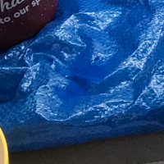

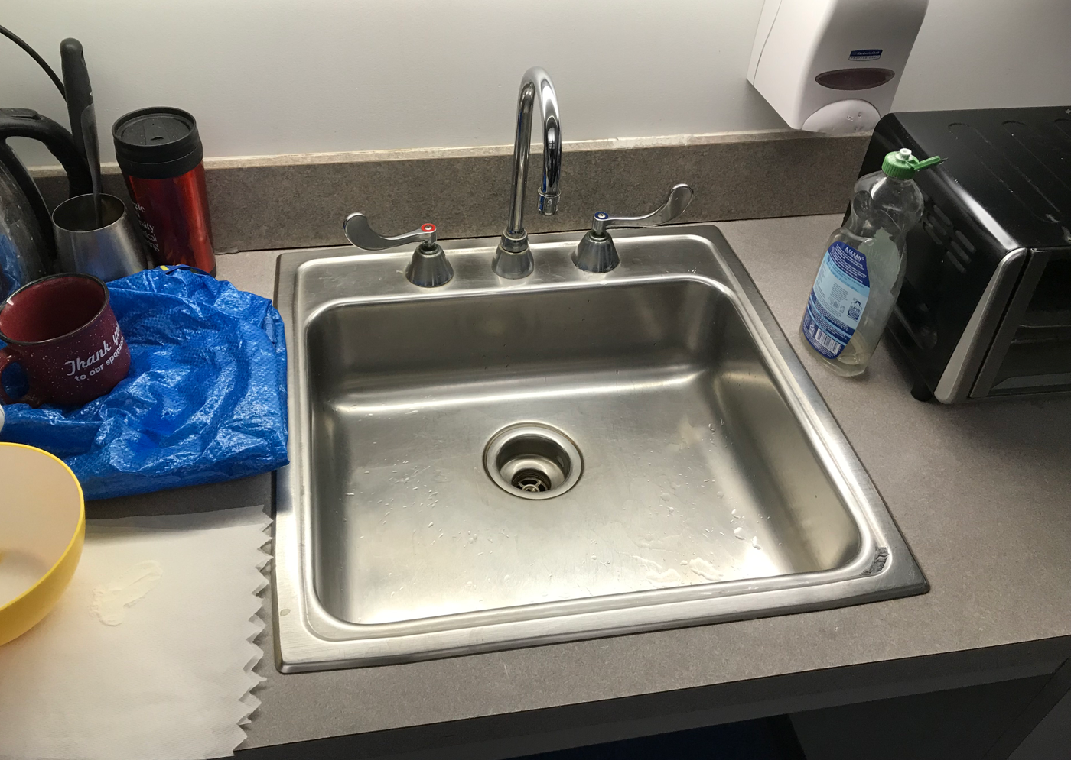
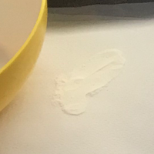
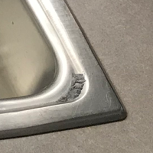
Challenge #1 – Lack Useful Information
Shape
Context
Texture
Color
Cyan Toner
Chicken Bathing
Powder
Silver Metallic
Powder
Coffee Mate
Notes:
However, finding and recognizing powders could be very hard. For example, in this image, there are four powder samples, can you find them? Even if we know where they are, it’s very hard to know what they are. It is because we do not have enough useful information to distinguish between different powders and between powders and backgrounds. Algorithms may use shape, context, texture, and color information for recognizing objects. But powders have no specific shape. They can be deposited on any surfaces. They are textureless. And many different powders can have the same color.

Slide 4
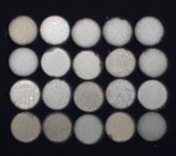
Challenge #1 – Lack Useful Information
20 Different White Powders
Notes:
Here is a example of 20 different powders that look very similar in a RGB image.

Slide 5
RGBN-SWIR Multispectral Imaging
Visible Light (RGB) 400-700nm | Near Infrared (NIR) 700-1000nm | Short-wave Infrared (SWIR) 1000-1700nm
Notes:
To solve this problem, we propose to have look at a wider range of the spectrum. We can see that as the wavelength get longer, those powders show significantly different appearances, especially in shortwave infrared bands.

Slide 6
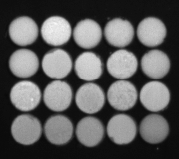
RGBN-SWIR Multispectral Imaging
Visible Light (RGB) 400-700nm | Near Infrared (NIR) 700-1000nm | Short-wave Infrared (SWIR) 1000-1700nm

Slide 7
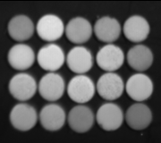
RGBN-SWIR Multispectral Imaging
Visible Light (RGB) 400-700nm | Near Infrared (NIR) 700-1000nm | Short-wave Infrared (SWIR) 1000-1700nm

Slide 8
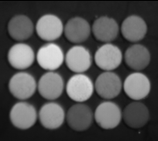
RGBN-SWIR Multispectral Imaging
Visible Light (RGB) 400-700nm | Near Infrared (NIR) 700-1000nm | Short-wave Infrared (SWIR) 1000-1700nm

Slide 9
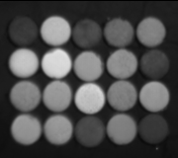
RGBN-SWIR Multispectral Imaging
Visible Light (RGB) 400-700nm | Near Infrared (NIR) 700-1000nm | Short-wave Infrared (SWIR) 1000-1700nm

Slide 10
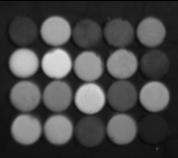
RGBN-SWIR Multispectral Imaging
Visible Light (RGB) 400-700nm | Near Infrared (NIR) 700-1000nm | Short-wave Infrared (SWIR) 1000-1700nm

Slide 11
RGBN-SWIR Multispectral Imaging
Visible Light (RGB) 400-700nm | Near Infrared (NIR) 700-1000nm | Short-wave Infrared (SWIR) 1000-1700nm
Notes:
In practice, we found that using a RGB image, together with a NIR channel, and 4 SWIR channels are enough for our task.

Slide 12
RGBN-SWIR Multispectral Imaging
45° Mirror
SWIR
Hyperspectral
Camera
Target
NIR
RGB
Notes:
To capture such data, we co-locate a RGB camera, a NIR camera, and a SWIR hyperspectral camera, and image the target through a 45 degree mirror. The spectrum of the SWIR camera is controlled by two voltage settings.

Slide 13
Capture Multispectral
Powder and Background Images
?
Machine
Learning
Notes:
Now it looks that we just need to capture enough data and use them to train a machine learning model. But in practice, it does not work, let’s see why.

Slide 14
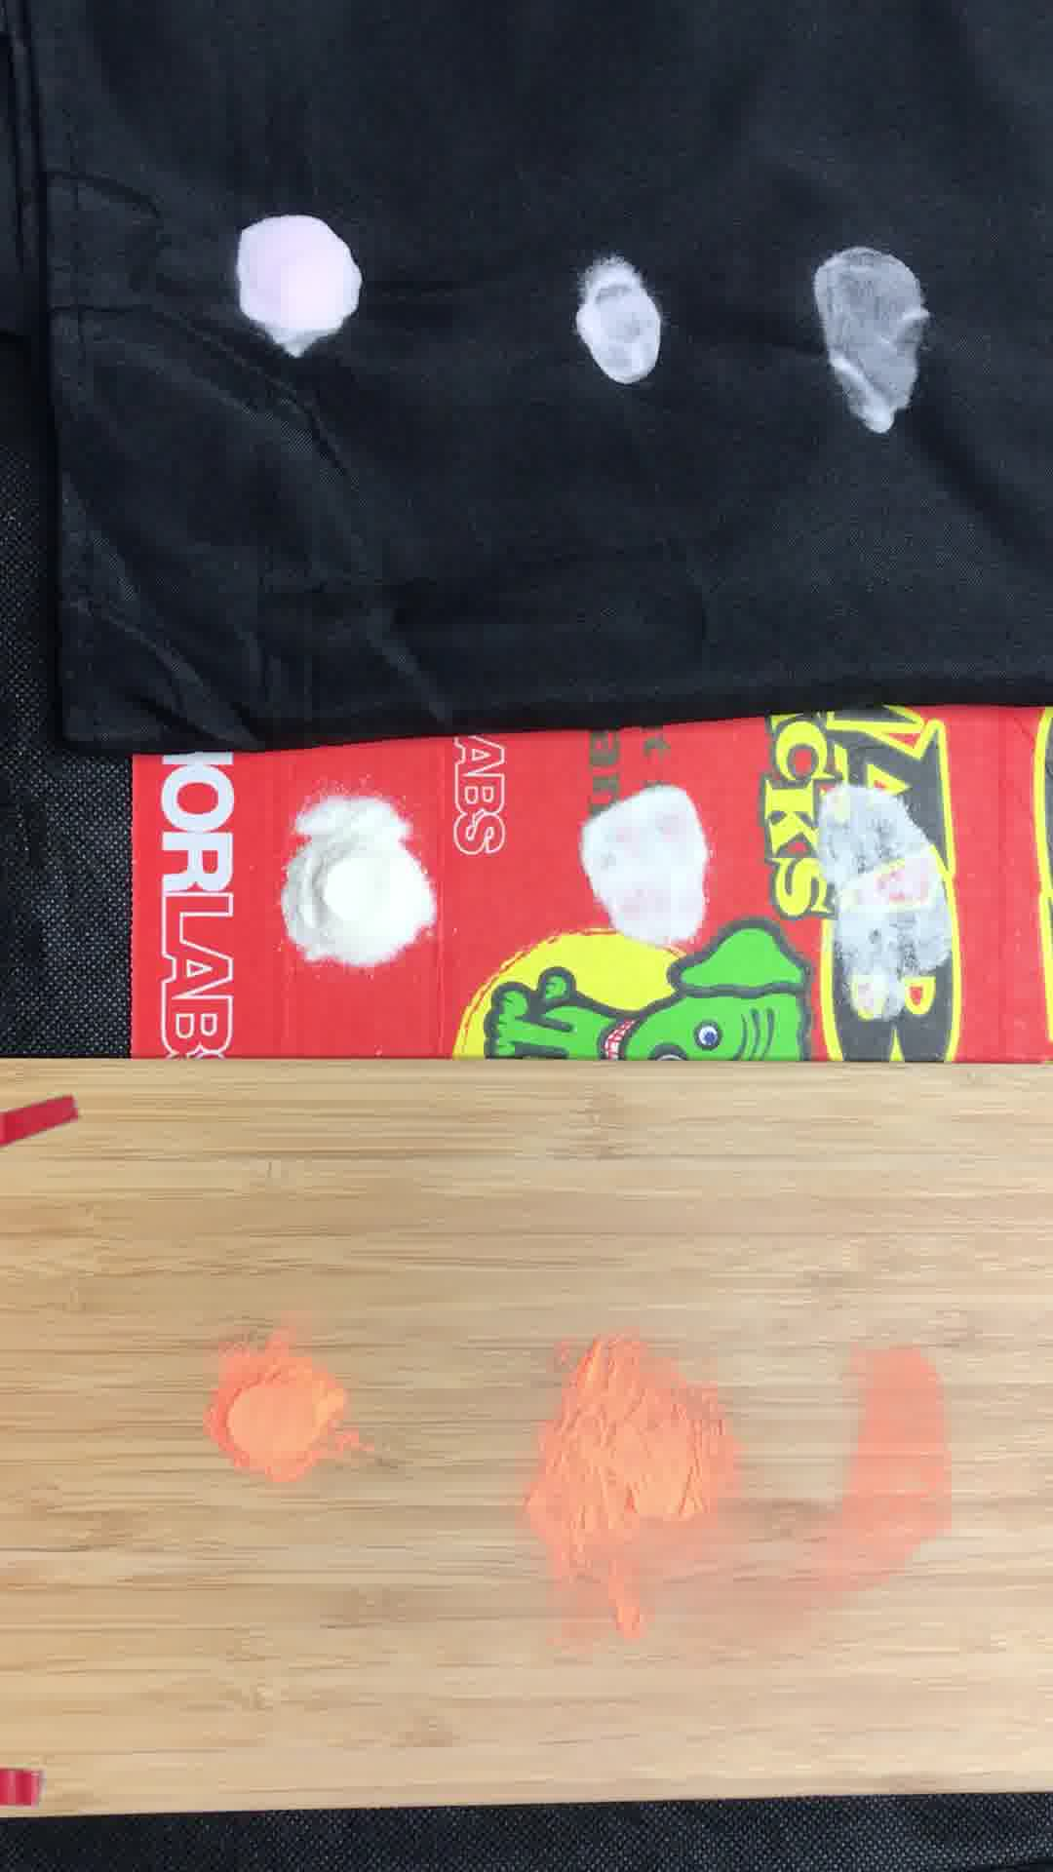
Challenge #2 – Thin Powder on Background Appearance
Thin
Thick
Notes:
Here are three different powders on different backgrounds. We can see that powders are translucent and the its transparency depends on its thickness. It means that the thin powder color depends on the powder color, the background color, and the thickness of the powder.

Slide 15
Challenge #2 – Thin Powder on Background Appearance
#Powders X #Backgrounds X #Thicknesses X #Lights
100 X 100 X 10 X 10
= 1,000,000 images
=20 years to capture data
Notes:
To capture a dataset covering different powders, backgrounds and thicknesses, it may take me 20 years. Because I need to prepare the powders and backgrounds, capture the data, and clean the table.

Slide 16
Approach – Pipeline
Capture Multispectral
Powder and Background Images
Render
Powder on Background Images
Machine
Learning
Notes:
To solve this problem, we propose to render thin powder on background images by blending thick powder and background images.

Slide 17

Approach – Render Thin Powder on Background Image
The Beer Lambert Blending Model:
Thin Powder
“Thick” Powder
Background
$$I_{c}=\left(1−α_{c}\right) { A}_{c} + α_{c} B_{c}$$
Channel
Index
Thickness
$$α_{c}=e^{−κ_{c}x}$$
Attenuation Parameter
Notes:
We propose a model that assumes the thin powder intensity is a per-channel alpha blending between thick powder and background intensities. The alpha value follows the Beer-Lambert law. The model parameters are easy to calibrate using a thick powder patch, a thin powder patch, and a background patch.

Slide 18
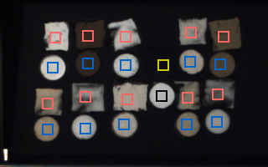
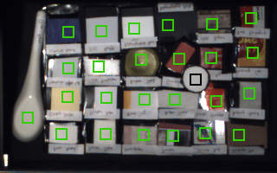
RGBN-SWIR Powder Recognition Database – Patches
Thick/Thin Powder Patches
Background Material Patches
Notes:
We build such patch dataset of 100 powder samples and 100 background materials.

Slide 19
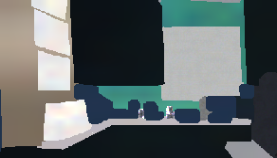
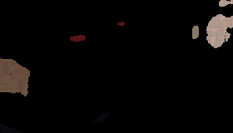
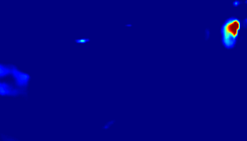
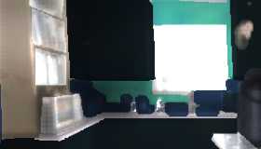

Render Thin Powder on Background Image
Background
Thick Powders
Powder Thickness Map
Thin Powders on Background
Ground Truth Label
Notes:
We composite and blend the background and powder patches to render thin powder on background images.

Slide 20
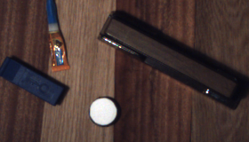
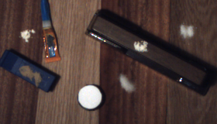

RGBN-SWIR Powder Recognition Database – Scenes
Background Scene
Scene with Powder
Ground Truth Label
Notes:
We also captured a dataset of real powder on background scenes with ground truth labels.

Slide 21
Ajinomoto Almond Flour
Aqua Glow Aspirin
Baby Powder Baking Soda
Barley Water BB Powder
Beach Sand Blackboard Chalk
Black Frit Black Iron Oxide
Black Pepper Black Toner
Blue Pigment Borax Detergent Booster
Boric Acid Bronze Metallic
Brown Dye Brown Sugar
Calcium Carbonate Cane Sugar
Caralluma CC Powder
Celtic Sea Salt Charcoal
Chaste Tree Berry Chicken Bath
Citric Acid Cobalt Frit
Cocoa Coconut Flour
Coconut Oil Coffe Mate
Corn Starch Cream of Rice
Cream of Tartar Cream of Wheat
Cyan Toner Detox Powder
Dragon Blood Dry Milk
Espresso Eye Shadow
Fake Moss Flower Fuel
Fuchsia Dye Fungicide
Garlic Ginger
Green Bean Water Green Glow
Green Pigment Guar Gum
Gym Chalk Hibiscus
Iodized Salt Loose Powder
Lotus Magenta Toner
Matcha MCT Oil
Meringue Milk Replacer
Moringa Nail Dipping
Onion Orange Glow
Orange Peel Pearl Powder
Pet Moist Potassium Iodide
Potato Starch Quick Blue Bleach
Red Bean Water Root Destroyer
Sandalwood Schorl Tourmaline
Shaving Powder Silver Metallic
Smelly Foot Powder Sodium Alginate
Spanish Paprika Stain Remover
Stevia Stone Cement
Sun Powder Talcum
Teal Azul Dye Tide Detergent
Urea Vanilla
Vitamin C Wheat Grass
White Pepper Yellow Dye
Yellow Glow Yellow Pigment
Yellow Toner Zinc Oxide
Experiments – Recognition with Known Powder Location
100 Powder Names
Top-N Retrieval | 100-Class Accuracy (%)
1 | 64.0
3 | 86.0
5 | 88.5
7 | 92.5
Notes:
Here’re our experimental results and the powder names are shown on the right. We first assume that the powder location is known and we only need to predict what kind of powder it is. Our method based on Nearest Neighbor achieved over 60% top-1 accuracy. It is 20% higher than the method without the blending model.

Slide 22
Experiments – Recognition with Known Powder Location
0.7
0.6
0.5
0.4
0.3
0.2
0.1
0.64
Accuracy
4 SWIR Bands + RGB + NIR
0 5 10 15 20 25
Number of SWIR Bands
Notes:
We also show that only 4 SWIR bands, together with RGB and NIR, are enough for recognizing powders.

Slide 23
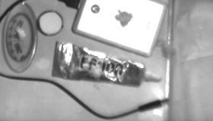
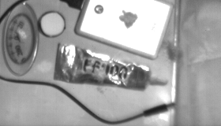
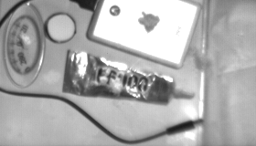


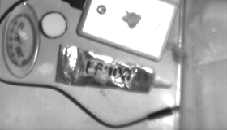
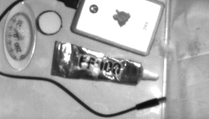
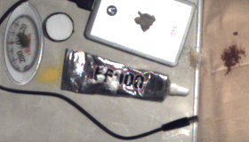
Experiments – Recognition with Unknown Powder Mask
Input Image Our Result Ground Truth
Notes:
The second experiment assumes that the powder location is unknown. It becomes a segmentation task. Our result based on deep learning is very similar to the ground truth result.

Slide 24
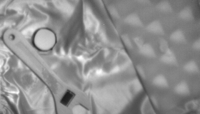
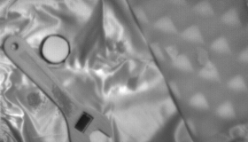
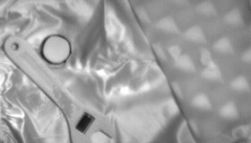


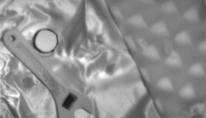
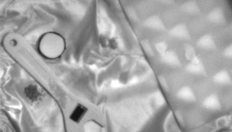
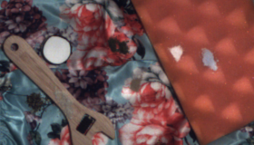
Experiments – Recognition with Unknown Powder Mask
Input Image Our Result Ground Truth

Slide 25
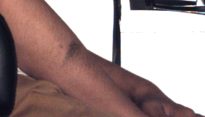
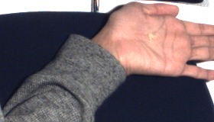
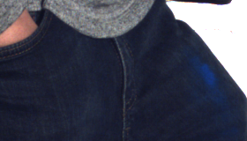



Application – Detect and Recognize Powders on Human
Notes:
Our method can also detect powders samples on humans which are not perfectly static. In the future, we will have a look at a wider range of the spectrum, like mid-wave infrared, and X-ray, to reach a higher accuracy and to detect powders behind surfaces.

Slide 26
Thank You!
Poster D80
imaging.cs.cmu.edu
Multispectral Imaging for Fine-Grained Recognition of Powders
on Complex Backgrounds
Tiancheng Zhi, Bernardo R. Pires, Martial Hebert, Srinivasa G. Narasimhan

